Slide 1
Stroke Prediction
Eduardo Herrera
Antonio Cruz
Thanh Ha
Joshua Wilks

Slide 2
Overview and Objective
According to the World Health Organization (WHO) stroke is the 2nd leading cause of death globally, responsible for approximately 11% of total deaths. This dataset is used to predict whether a patient is likely to get stroke based on the input parameters like gender, age, various diseases, and smoking status.
Our goal is to visualize relationships between variables to uncover unhealthy habits that may lead to strokes. In addition, we seek to build models that are able to predict the probability a stroke will occur given a variety of health factors.

Slide 3
Attributes Included in Model
Id
Gender (Male, Female, Other)
Age
Hypertension (0 for No, 1 for Yes)
Heart Disease (0 for No, 1 for Yes)
Work Type
Average Glucose
BMI
Smoking Status
Married
Residence Type
Stroke (Target Variable)

Slide 4
Data Exploration

Slide 5
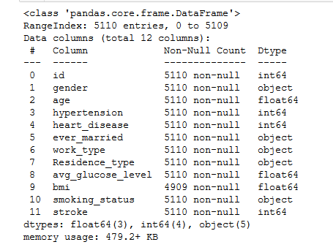
Data Info

Slide 6
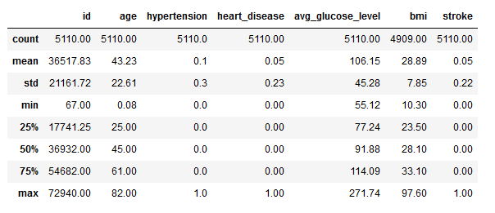
Summary Statistics for Numerical Variables

Slide 7
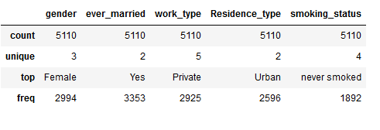
Summary Statistics for Categorical Variables

Slide 8
Data Visualization

Slide 9
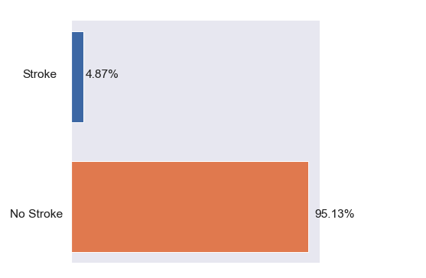
Distribution of Dataset and Baseline
Dataset is highly imbalance as 95% of the data predicts patients not being at risk of a stroke.
To rectify this, we balanced our data by oversampling.
Stroke Distribution in the Dataset

Slide 10
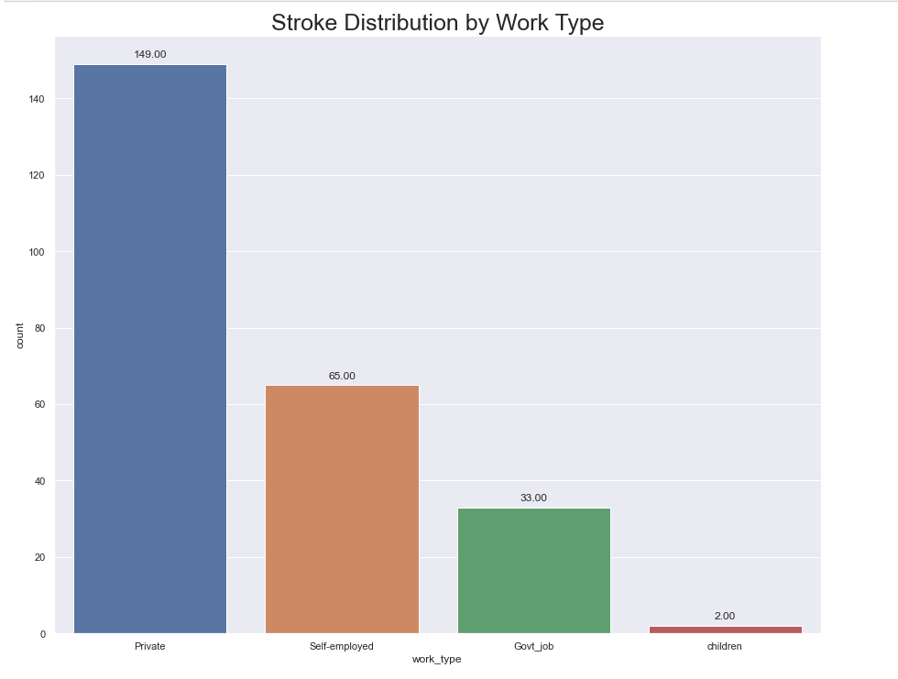
The Distribution of Strokes among Work Types
This Graph shows the total counts of strokes among work type. This may be deceiving.
The majority of strokes occurred in people work in the private sector.
However:
7.94% of self-employed people suffered strokes.
5.09% of private sector workers suffered strokes.
5.02% of government employees suffered strokes.
0.29% children suffered strokes.
So we see that people who are self-employed suffer strokes at a the highest rate.

Slide 11
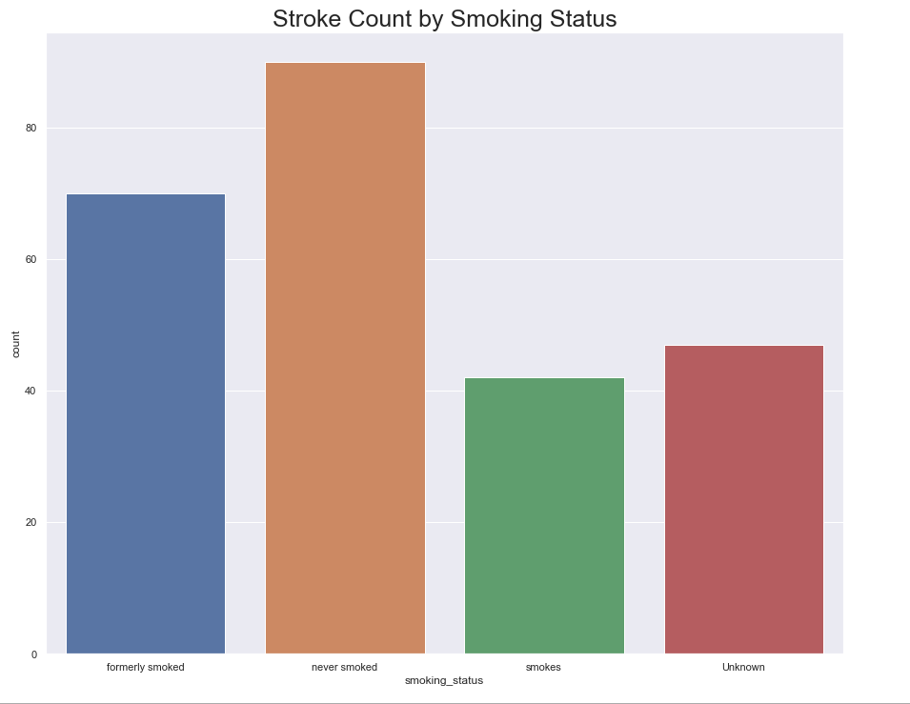
Stroke Distribution by Smoking Status
This graph shows the total count of people who suffered strokes for each smoking category.
People who never smoked suffered the most strokes.
However:
7.91% of former smokers suffered strokes.
5.32% of smokers suffered strokes.
4.76% of non-smokers suffered strokes.
3.04% of people with unknown status suffered strokes.
So we see that former smokers suffered strokes at the highest rate.

Slide 12
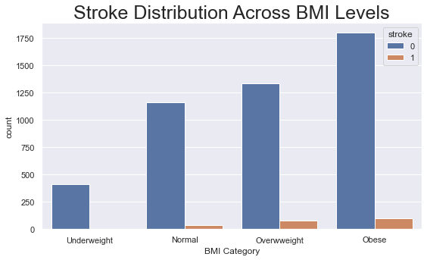
Stroke Distribution Across BMI Levels
According to the chart we can see a relationship between weight and the proportion of strokes.
As weight decrease, the chance of getting a stroke also decreases.

Slide 13
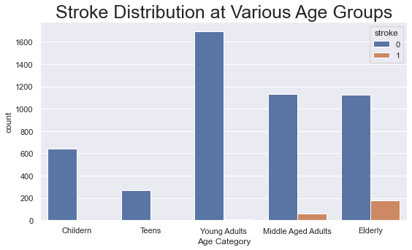
Stroke Distribution at Various Age Groups
According to the chart, that strokes almost exclusively occur in the higher age groups.
For our analysis, Middle Aged Adults are considered as people between the ages of 45 and 60.
While elderly are considered to be over the age of 60.

Slide 14
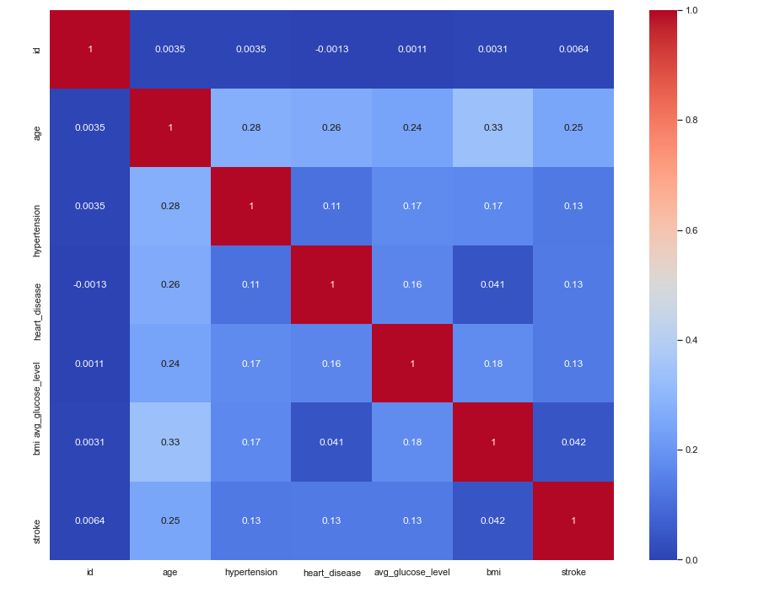
Correlation Heatmap

Slide 15
Data Processing

Slide 16
Data Processing
BMI variable had 209 missing values. We filled in the missing values using the median of 28.1.
Re-coded categorical values with two unique values as binary.
Residence Type
Ever Married
Used One-Hot-Encoder to encode variables with more than two unique levels.
We scaled the BMI, Average Glucose Level, and Age variables.
Used SMOTE oversampling to balance data.
Before oversampling the distribution of strokes in the data set was 5% vs 95%
After oversampling the distribution of strokes was even at 50%.
Used an 80% Training, 20% Test (Validation) Split to run our models

Slide 17
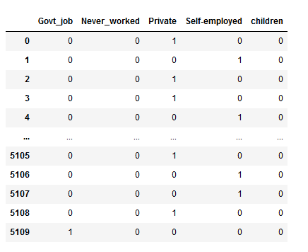
One Hot Encoder
We used a package called One Hot Encoder to create dummy variables for variables with more than two unique levels.
We created dummy variables so that the algorithms we use for modeling would not interpret higher values as having a hierarchy and assigning them more value.
For example, work type had 5 unique levels.
Private
Self-employed
Govt_job
Children
Never_worked

Slide 18
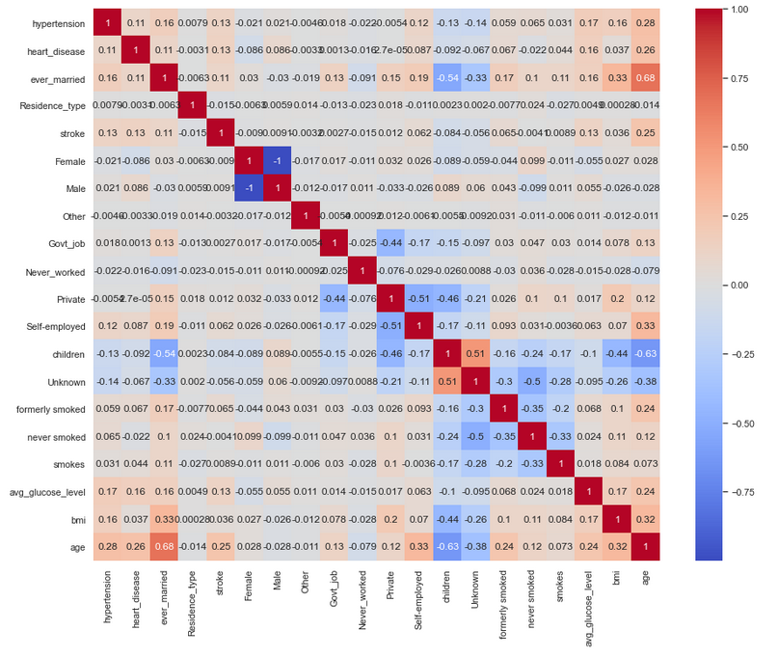
Updated Correlation Heatmap After Data Processing

Slide 19
Models

Slide 20
Models Used in our Analysis
Logistic Regression
Linear Regression
Naive-Bayes
Decision Trees
SVC
K-Nearest Neighbors
Gradient Boosting
Random Forest

Slide 21
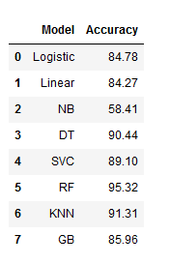
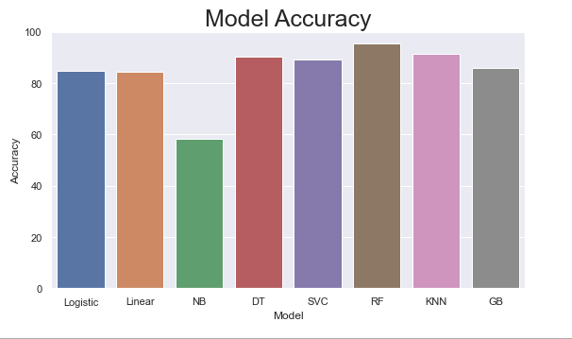
Model Evaluation

Slide 22
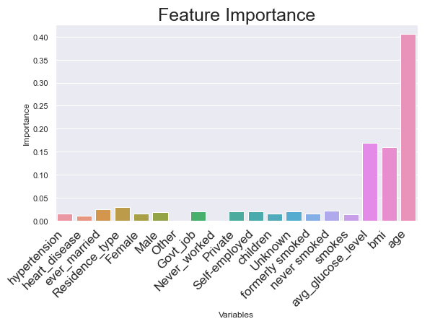
Feature Importance for the Random Forest Model

Slide 23
Conclusion
Random Forest was best performing model with a 95.5% accuracy score and the best evaluation metrics (F1, precision, and recall).
The most important features were Age, BMI, and Average Glucose Level.
Random Forest model is the only model to outperform baseline model (95% prediction for no stroke).

